Slide 1

Maryland Vehicle Crash Analysis
Team 6:
Akhileshwar Rao Emmanani (NI74131)
Abhinav Mishra (ME23298)
Vishwanath Gogi (PR47776)

Slide 2
Problem Statement
Every year, hundreds and thousands of vehicle crashes occur in the United States, causing injuries, fatalities, and significant economic losses. In Maryland alone, there were over 100,000 vehicle crashes in 2021. Analyzing the data from these crashes can help us identify patterns, trends, and contributing factors, which can inform policies and interventions to improve road safety.

Slide 3
Introduction
In this presentation, we will analyze the data on vehicle crashes in Maryland using big data processing technologies. We will examine various factors such as the time and location of the crashes, types of vehicles movement involved, and the severity of the crashes. By doing so, we aim to identify insights and trends that can help policymakers and stakeholders make informed decisions to reduce the number of vehicle crashes in Maryland.

Slide 4
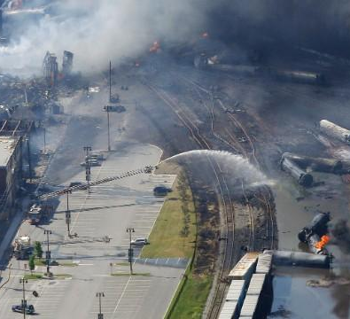
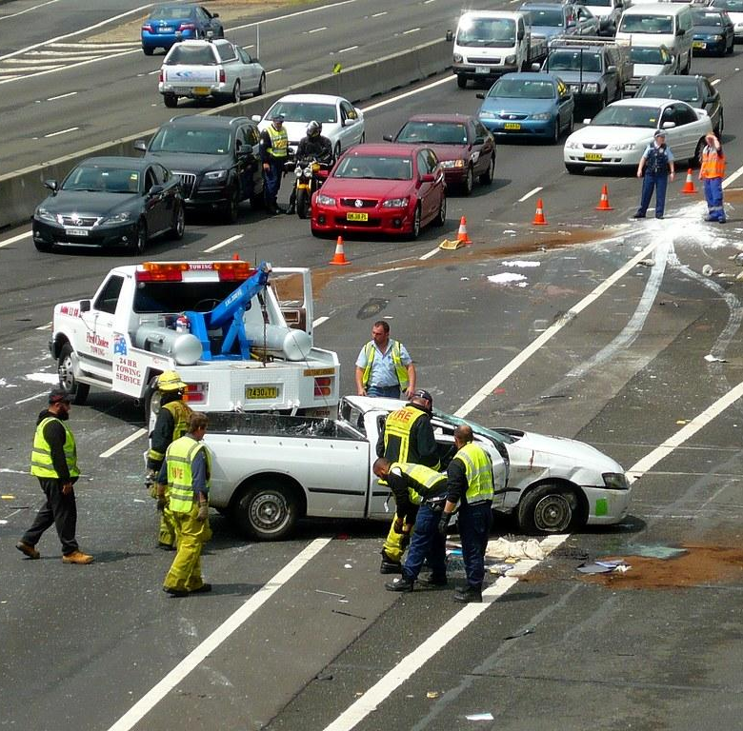
Factors Influencing Vehicle Crashes in Maryland
Weather
Area
Time of the day
Road conditions
Vehicle conditions
Alcohol consumed by the driver
The data contains the details of vehicle crashes that occurred between January 2015 to June 2022.
Exploratory Data Analysis for Statistical inference and to take measures accordingly.

Slide 5
Datasets
The dataset we used is Maryland Crash Data Resources. The data for this dataset is provided by Maryland state police. We used three datasets from this resource page, which are the tables of our database
Maryland_Statewide_Vehicle_Crashes (55 columns and 848804 rows)
Maryland_Statewide_Vehicle_Crashes_-_Person_Details__Anonymized (48 columns and 1903316 rows)
Maryland_Statewide_Vehicle_Crashes_-_Vehicle_Details (49 columns and 1386222 rows)
Crashes spanning over 7 years, in different counties, in each quarter.
Vehicle movement and weather condition effects.

Slide 6




Technologies Used

Slide 7
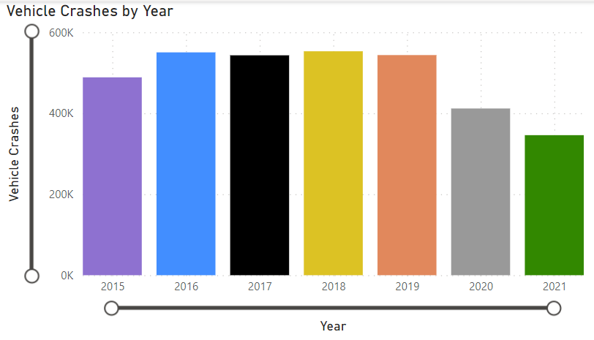

Slide 8
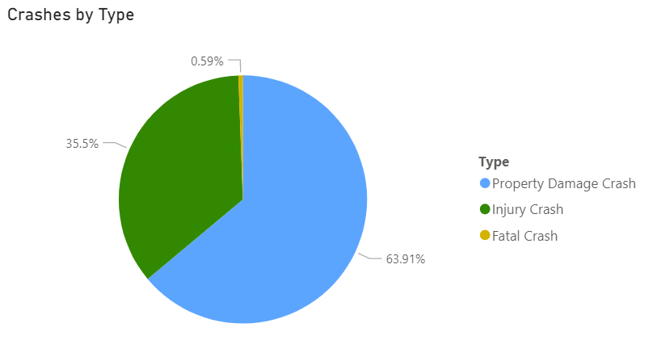

Slide 9
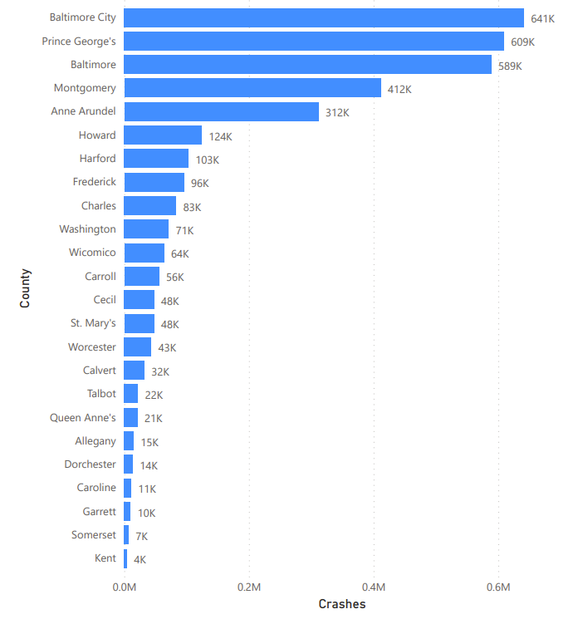
Accidents in Different Counties

Slide 10
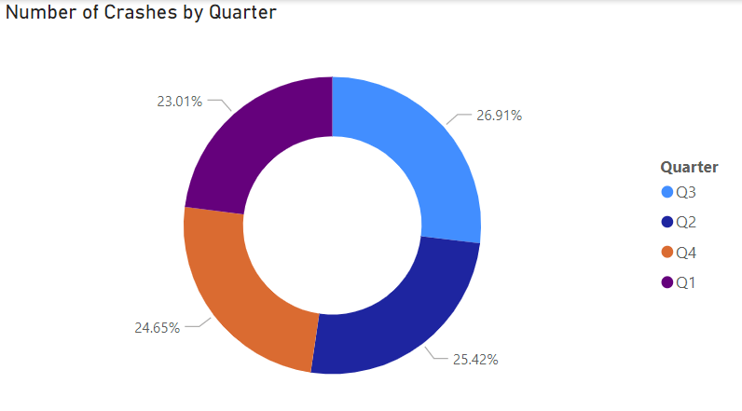

Slide 11
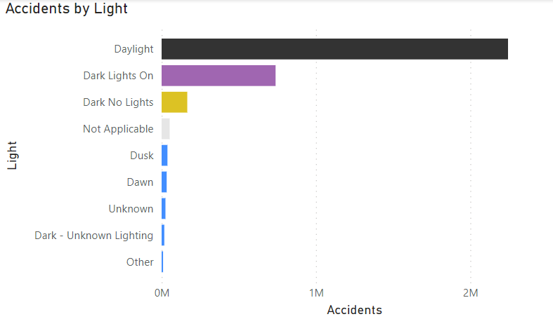
Influence of Time on crashes

Slide 12
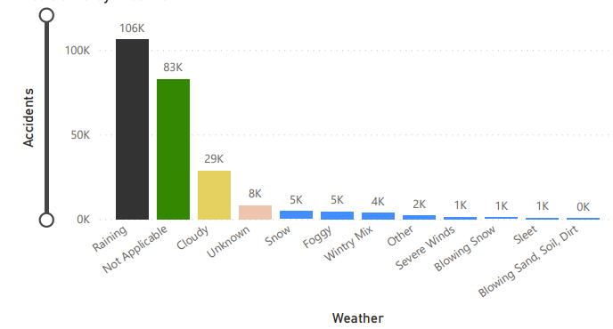
Influence of weather on crashes

Slide 13
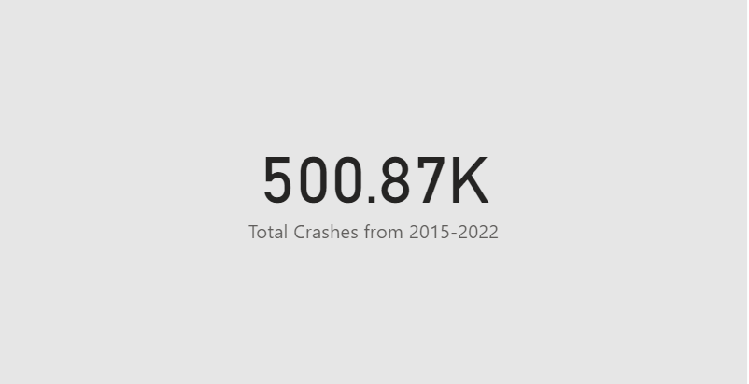

Slide 14
Observations
Maryland's dominant weather under crashes is rain followed by cloudy weather
A drop in number of crashes in 2020-21 due to the pandemic
Baltimore County has the most number of crashes followed by Prince George
Possible influence from summer break in Q3.
Most of the crashes resulted in Property damage, while fatal crashes were low.
Large number of crashes took place during daylight.

Slide 15
Takeaway
Drivers should always pay attention to the road and avoid distractions such as cell phones.
Speed limits should be obeyed, particularly in high-risk areas such as school zones and construction zones. Young drivers should be educated on driving that may benefit from driver training.
Road infrastructure and safety measures should be improved in high-risk areas such as Baltimore City and Montgomery County.
More research should be conducted to understand the reasons behind the increasing number of crashes in Maryland.

Slide 16
Discussion and future work
Predictive modeling: Use machine learning algorithms to build predictive models that can identify factors that contribute to accidents, and predict the likelihood of future accidents based on historical data.
Real-time monitoring: Develop a real-time monitoring system that can capture and analyze data from various sources, such as social media, weather reports, and traffic cameras, to detect potential accident risks and alert drivers and authorities.
Spatial analysis: Conduct a spatial analysis of accident hotspots in Maryland and identify the underlying factors that contribute to these locations. This could involve examining demographic, environmental, and infrastructure-related factors.

Slide 17

Conclusion
In conclusion, analyzing data on vehicle crashes in Maryland can provide valuable insights into the factors contributing to these incidents. Big data processing technologies such as Apache Hadoop and Apache Spark can help us analyze large amounts of data quickly and efficiently. The findings from our analysis can inform policymakers and stakeholders in making evidence-based decisions to reduce the number of vehicle crashes in Maryland and improve road safety for everyone.

Slide 18
References
Maryland Crash and Traffic Fatalities Data. (n.d.). Zero Deaths Maryland & Vision Zero - Maryland Highway Safety Office. https://zerodeathsmd.gov/resources/crashdata/
Maryland Statewide Vehicle Crashes | Open Data | opendata.maryland.gov. (n.d.). Opendata.maryland.gov. https://opendata.maryland.gov/ Public-Safety/Maryland-Statewide-Vehicle-Crashes/65du-s3qu
Querrying https://www.machinelearningplus.com/pyspark/pyspark-withcolumn/

